Slide 1
Statistical Models and Model Estimations

Slide 2
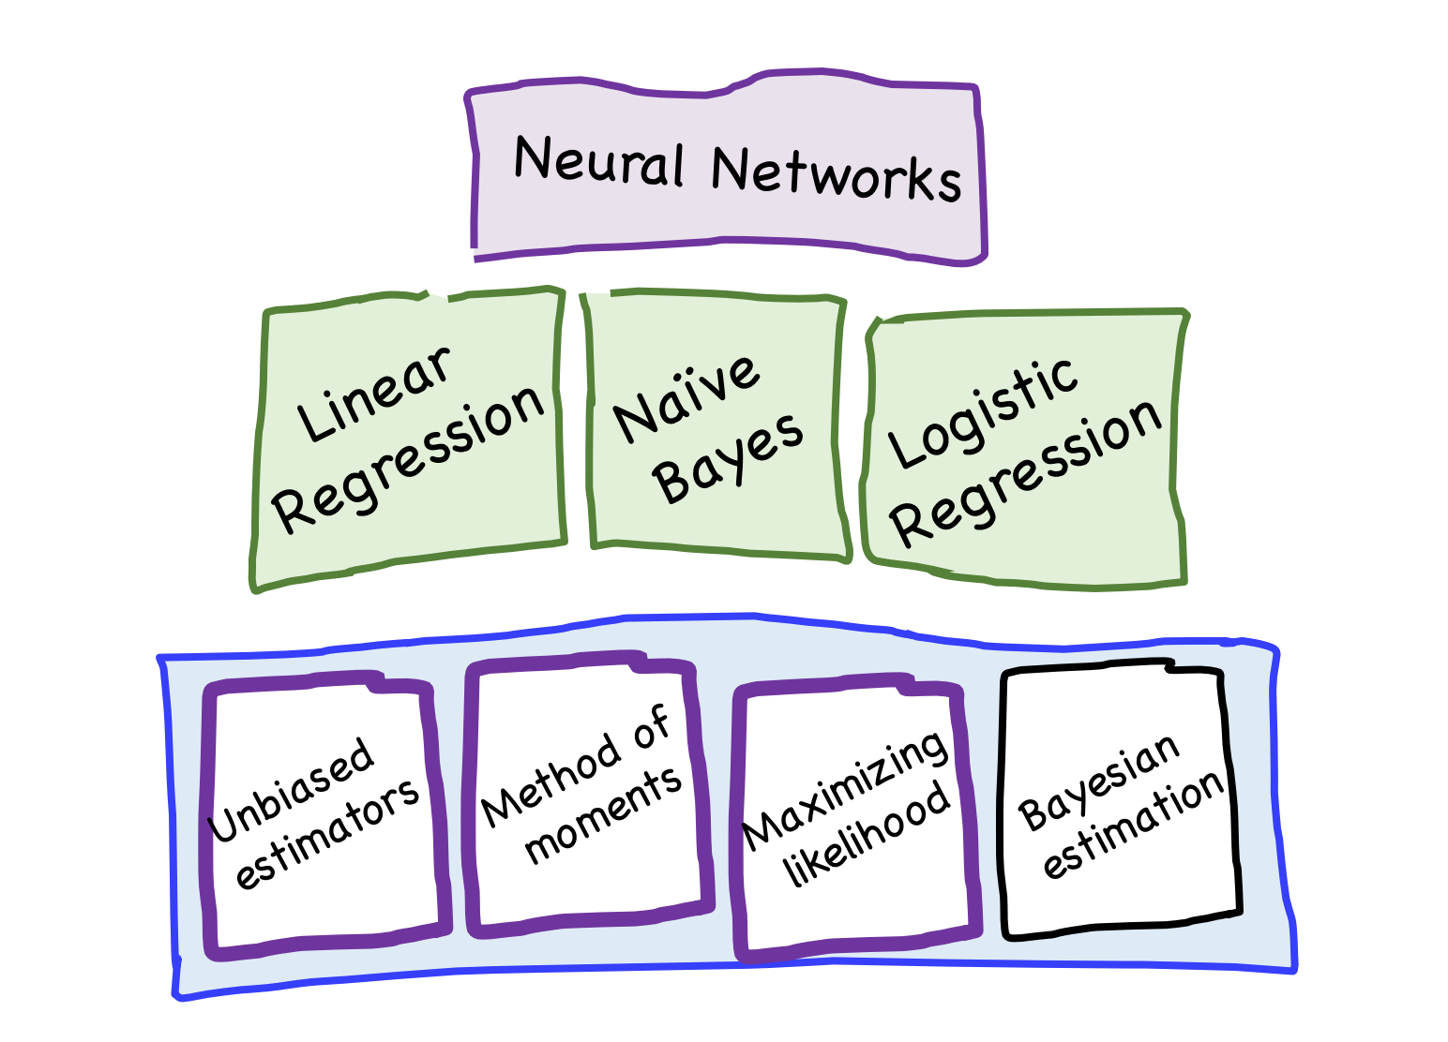

Slide 3
Outline
By the end of this lecture you:
Can Perform Parameter Estimation and Distribution Fitting Using:
Methods of Moments
Maximum Likelihood Estimation (MLE)
Maximum A posterior (MAP)
Non Parametric Estimation (Kernel Density Function)

Slide 4
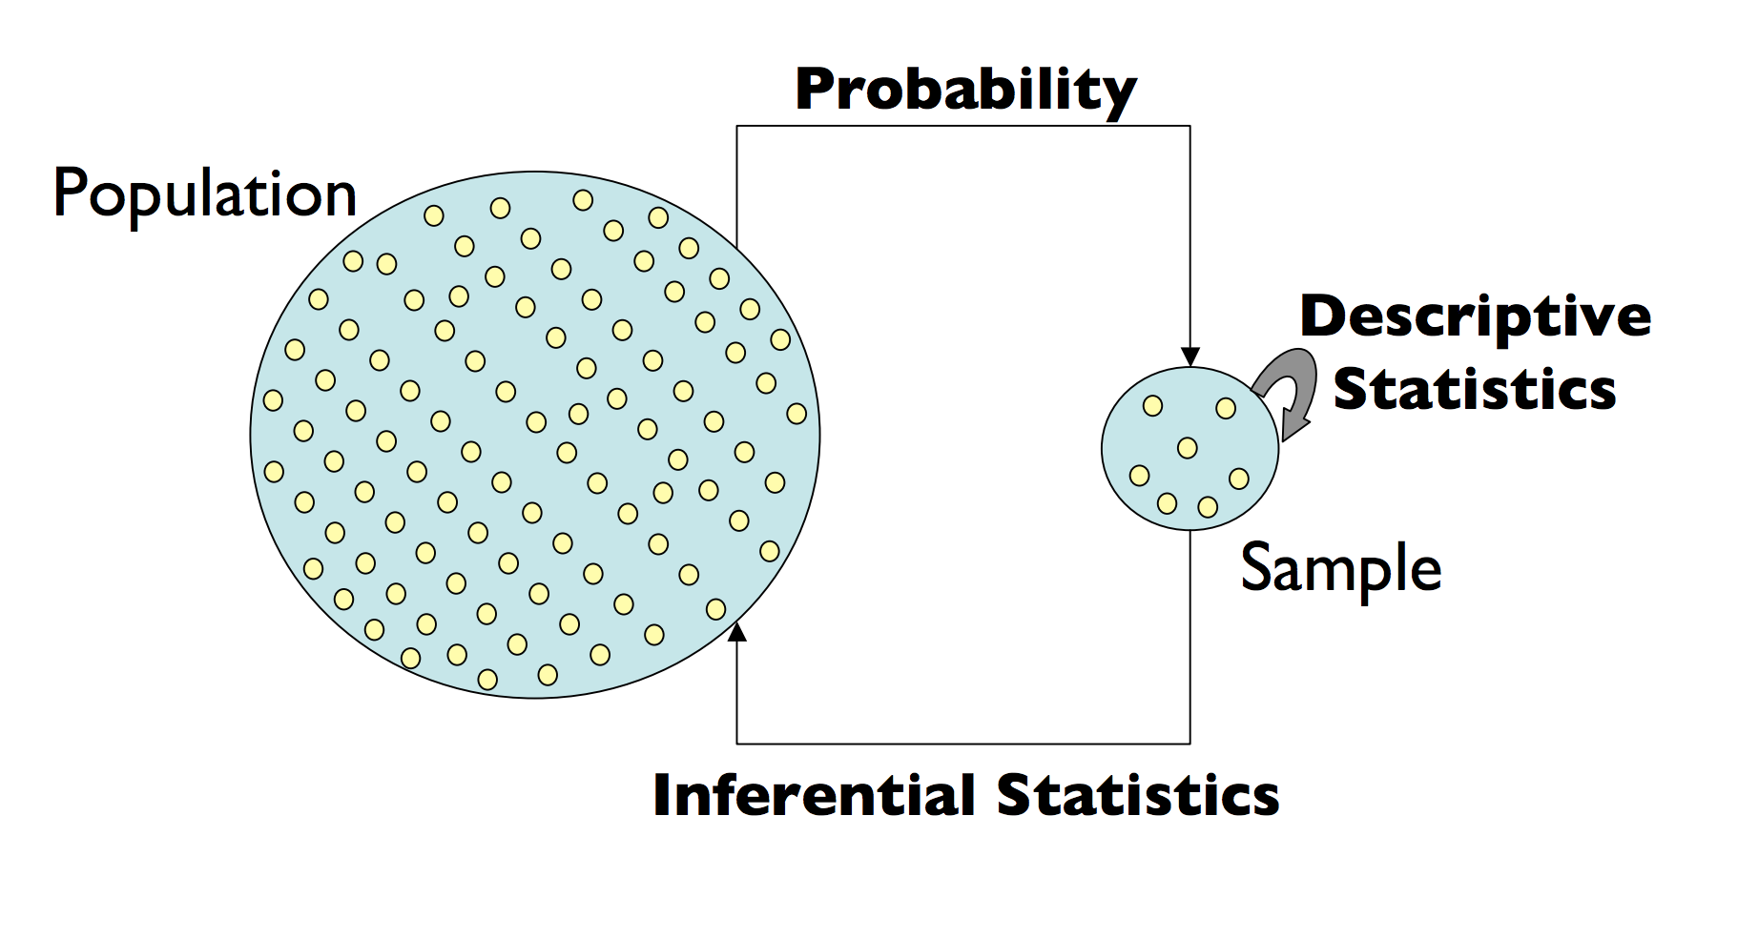
Probability vs Inference Statistics

Slide 5
Random Samples
The r.v.’ s (random variables’) X₁, X₂, . . . , X_{n} are said to form a (simple) random sample of size n if:
The X_{i} ’ s are independent r.v. ’ s.
Every X_{i} has the same probability distribution.
We say that these X_{i} ’ s are independent and identically distributed (i.i.d).
We use estimators to summarize i.i.d. sample.

Slide 6


Estimation
Estimator: Statistic whose calculated value is used to estimate a population parameter
Estimate: A particular realization of an estimator
Types of Estimators:
Point estimate: single number that can be regarded as the most plausible value of
Interval estimate: a range of numbers, called a confidence interval indicating, can be regarded as likely containing the true value of

Slide 7
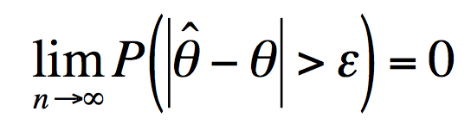
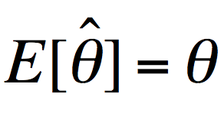
Good Estimator
There are many estimators for a population parameters. What are the characteristics of a good estimator:
Consistent: As the sample size increases gets closer to
Unbiased:
Precise: Sampling distribution of should have a small standard error

Slide 8
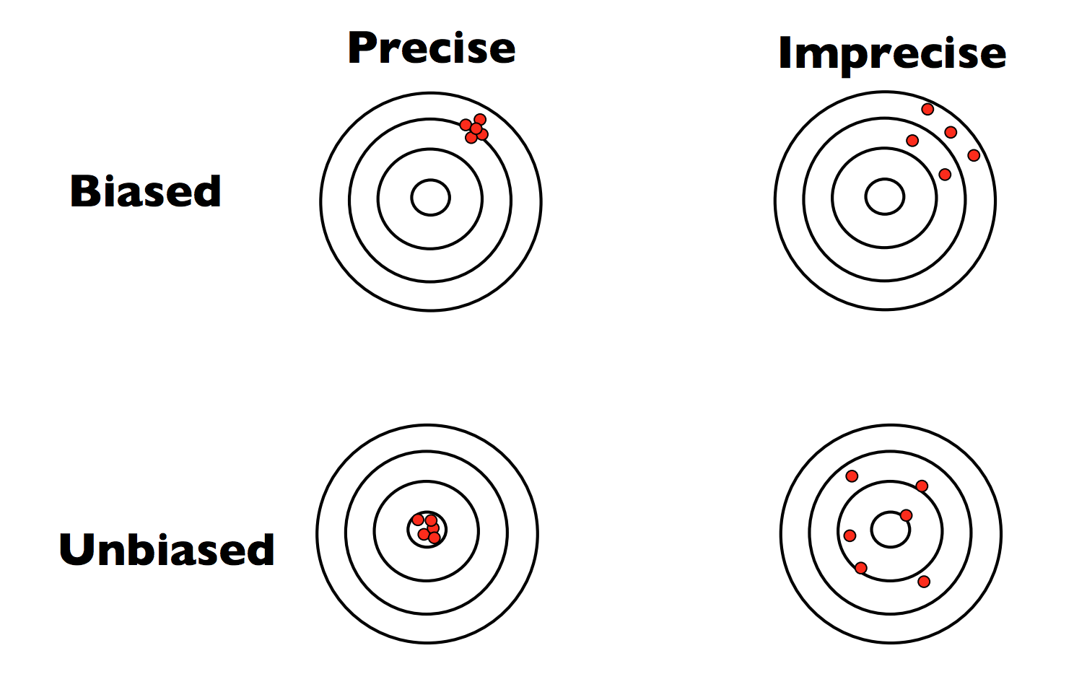
Biased vs Precise

Slide 9
Method of Estimation
Method of Moments
Maximum Likelihood Estimation (MLE)
Maximum A Posteriori (MAP)
Non Parametric Estimation (Kernel Density Function)

Slide 10
Method of Moments (MOM)
Advantage: Simplest approach for constructing an estimator
Disadvantage: Usually are not the “best” estimators possible
How it Works: Equate the kth population moment E[X^{k}] with the kth sample moment and solve for the unknown parameter.

Slide 11

Example
Your website visitor log shows the following number of visits for each of the last seven days: [6, 4, 7, 4, 9, 3, 5]. What’s the probability of zero visitors tomorrow?
What distribution could describe the data?
What parameters do we need to estimate and how do we estimate it?
There is only one parameter to estimate and we use the average of data to estimate the sample average which is 5.43!

Slide 12
Example - Cont
Import numpy as np
import matplotlib as mpl
import matplotlib.pyplot as plt
import seaborn
%matplotlib inline
from scipy import stats
mpl.rcParams.update({
'font.size' : 24.0,
'axes.titlesize' : 'large',
'axes.labelsize' : 'medium',
'xtick.labelsize' : 'medium',
'ytick.labelsize' : 'medium',
'legend.fontsize' : 'large',
})
mu = (6 + 4 + 7 + 4 + 9 + 3 + 5) / 7.
print (stats.poisson.pmf(0, mu))
x = np.arange(stats.poisson.ppf(0.00001, mu),
stats.poisson.ppf(0.99, mu))
fig, ax = plt.subplots(1, 1, figsize=(12, 5))
ax.plot(x, stats.poisson.pmf(x, mu), 'bo', ms=8, label='poisson pmf')
ax.vlines(x, 0, stats.poisson.pmf(x, mu), colors='b', lw=5, alpha=0.5)
ax.set_title("Poisson, $\lambda={:.4f}$".format(mu))

Slide 13
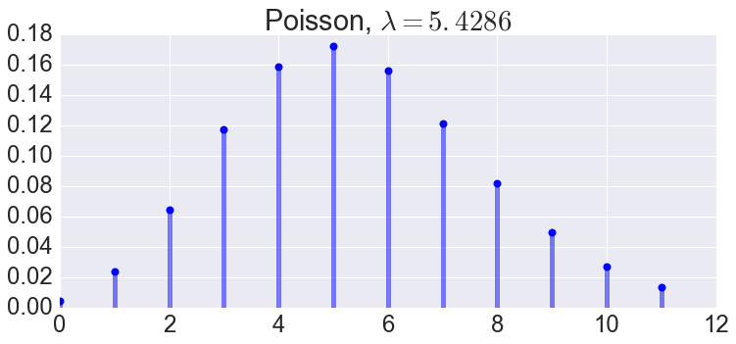
Example - Cont
The probability of zero visitor: 0.00438936184278

Slide 14
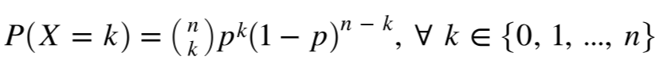
Example
You flip a coin 100 times. It comes up heads 52 times. What’s the MOM estimate that in the next 100 flips the coin will be heads <= 45 times?
What distribution could describe the data?
What parameters do we need to estimate and how do we estimate it?
We only have one data point which is 52. We set mean to be 52.
For Binomial distribution mean equals to np therefore p=0.52

Slide 15
Example
import matplotlib as mpl
import matplotlib.pyplot as plt
import seaborn
%matplotlib inline
from scipy import stats
mpl.rcParams.update({
'font.size' : 24.0,
'axes.titlesize' : 'large',
'axes.labelsize' : 'medium',
'xtick.labelsize' : 'medium',
'ytick.labelsize' : 'medium',
'legend.fontsize' : 'large',
})
n = 100
p = 0.52
print (stats.binom.cdf(45, n, p))
x = np.arange(stats.binom.ppf(0.001, n, p),
stats.binom.ppf(0.999, n, p))
fig, ax = plt.subplots(1, 1, figsize=(8, 6))
ax.plot(x, stats.binom.pmf(x, n, p), 'bo', ms=8, label='binom pmf')
ax.vlines(x, 0, stats.binom.pmf(x, n, p), colors='b', lw=5, alpha=0.5)
ax.set_title("Binomial PMF, n=100, p=0.52")

Slide 16
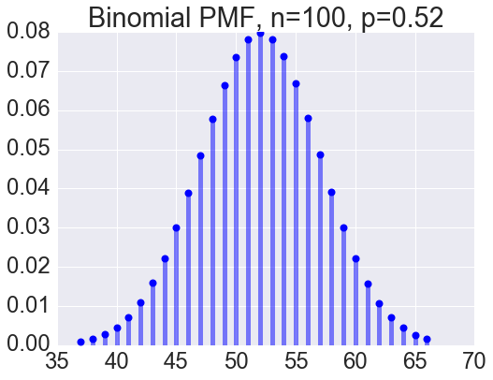
Example - Cont’
The probability that we get less than or equal 45 heads is 0.097!

Slide 17
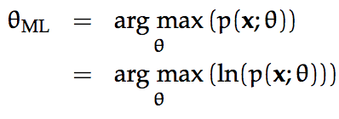
Maximum Likelihood Estimation (MLE)
The Maximum Likelihood estimate for a scalar parameter θ is defined to be the value that maximizes p(x; θ).
p(x; θ) is the likelihood function and ln(p(x; θ)) is the log-likelihood function. Note that it is equivalent to maximize either of these. Usually the log-likelihood is easier when the distribution is exponential:
The MLE is neither precise nor unbiased but it is not a poor estimator!

Slide 18
How it Works
Assume an underlying distribution for your domain. (just like with MOM) E.g. Poisson, Bernoulli, Binomial, Gaussian
Define the likelihood function. We want to know the likelihood of the data we observe under different distribution parameterizations.
Choose the parameter set that maximizes the likelihood function.

Slide 19
Example
You flip a coin 100 times. It comes up heads 52 times. What’s the MOM estimate that in the next 100 flips the coin will be heads <= 45 times?
Again which distribution we need to choose?

Slide 20
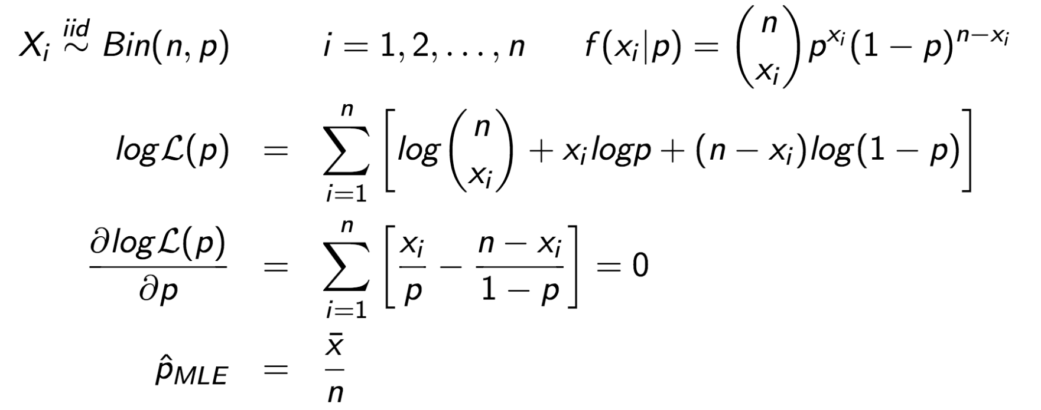
Example - Cont

Slide 21
Example
We have a list of data generate from a normal distribution. Apply MLE to find the best parameters which describe this set of data. The data are generated by:
import scipy.stats as scs
data = scs.distributions.norm(0.1,0.7).rvs(size=50)
We try to find mean and standard deviation which maximize the probability of observing the data!

Slide 22
Example - Cont
import numpy as np
import matplotlib.pyplot as plt
import scipy.optimize as optim
import scipy.stats as scs
import pandas as pd
from itertools import product
%matplotlib inline
data = scs.distributions.norm(0.1,0.7).rvs(size=50)
#print(data)
def log_likelihood_normal_two_parameters(mu, sigma_sq, data):
normal = scs.norm(mu, np.sqrt(sigma_sq))
likelihoods = [normal.pdf(datum) for datum in data]
return np.sum(np.log(likelihoods))
# The optimizer needs a function that consumes a single numpy array
def wrapper_for_scipy(x, data):
return -log_likelihood_normal_two_parameters(x[0], x[1], data)
fit_parms = optim.minimize(wrapper_for_scipy, (0, 1), args=(data), method='Nelder-Mead')
mu_best, sigma_sq_best = fit_parms.x
print("Log-Lik Optimal Parameters: mu = {0:2.3f}, sigma_sq = {1:2.3f}".format(mu_best, sigma_sq_best))
plt.hist(data, normed=True);
x = np.linspace(-2, 2, num=400)
normal = scs.distributions.norm(mu_best, sigma_sq_best)
plt.plot(x, normal.pdf(x))

Slide 23
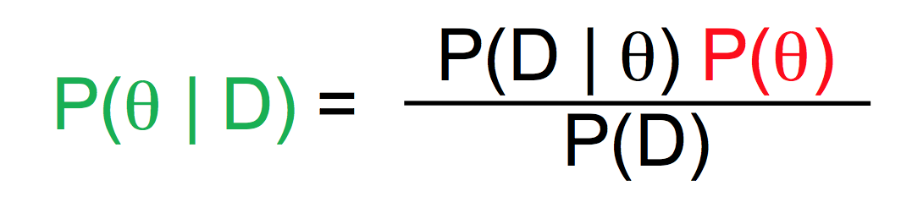
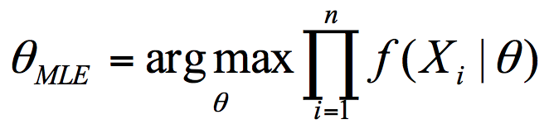
Maximum A Posteriori
Bayes’ Theorem with θ = model parameters and D = data:
P(θ) is the prior and show our belief without any information about the data.
In MLE we optimize P(D|θ) to obtain the best parameters which maximize the probability of data:

Slide 24
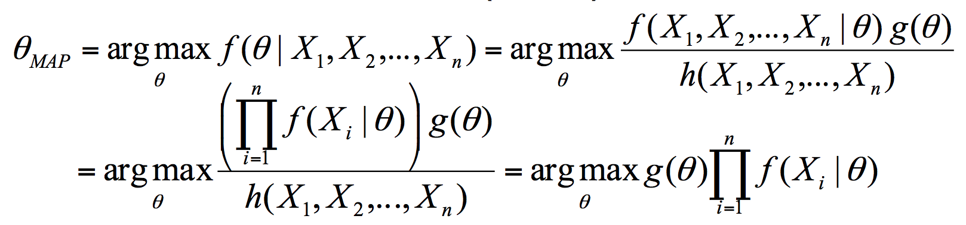
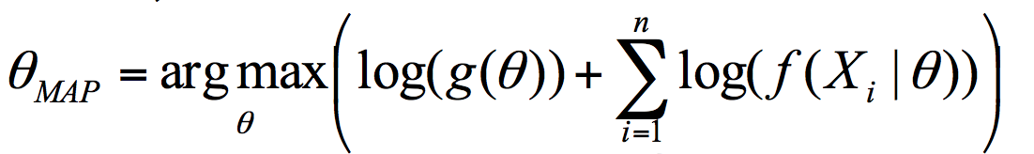
Maximum A Posteriori
In MAP we need to include our belief in finding parameters which optimize the probability of data:
It is better to use the log:

Slide 25
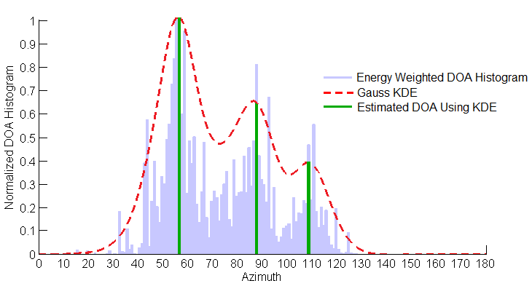
Histograms
Histograms are not smooth and their smoothness depends on the width of the bins. We use Kernel Density Estimators (KDE) to smooth them.

Slide 26
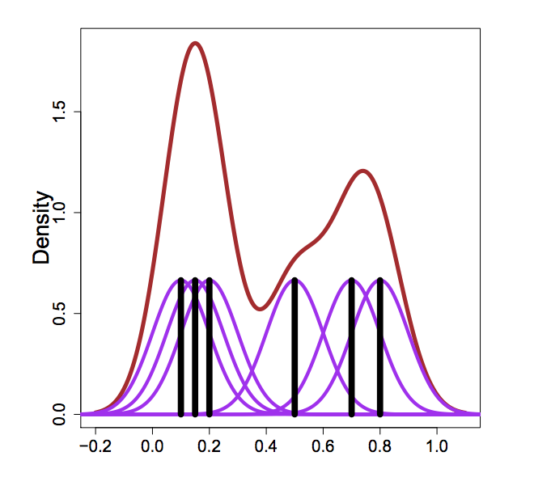
Non Parametric Estimation (KDE)
Consider we have six data points which show the positions of black vertical line. Let’s use six normal distribution (purple) to smooth the data and then sum them up to obtain the final density (brown).

Slide 27
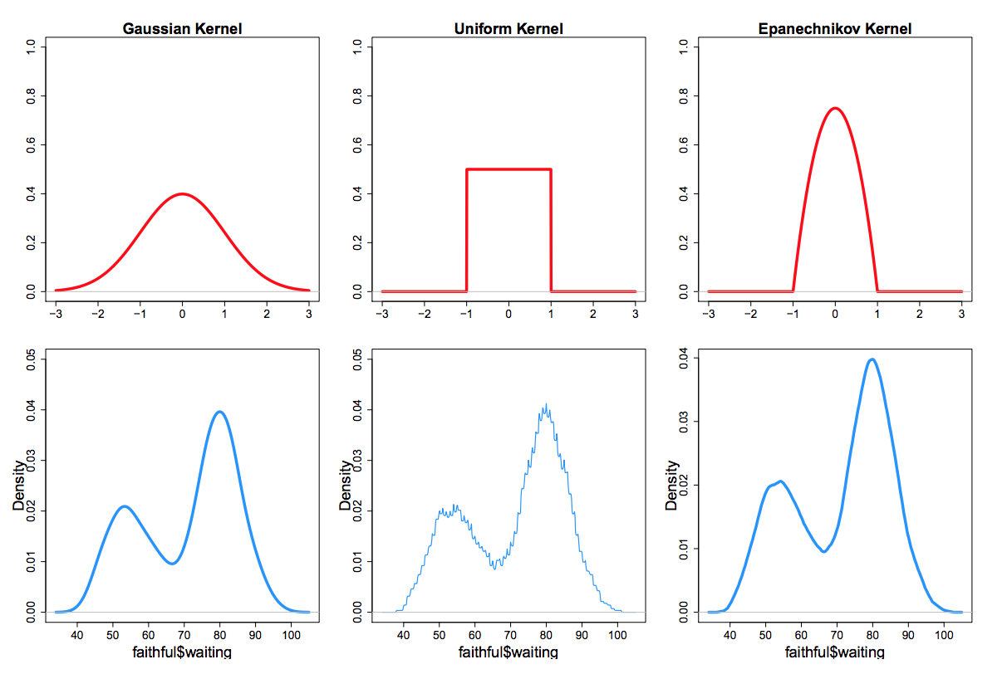
KDE - Kernels
Kernels are usually not important but in practice changing kernels could give lower mean square error.

Slide 28
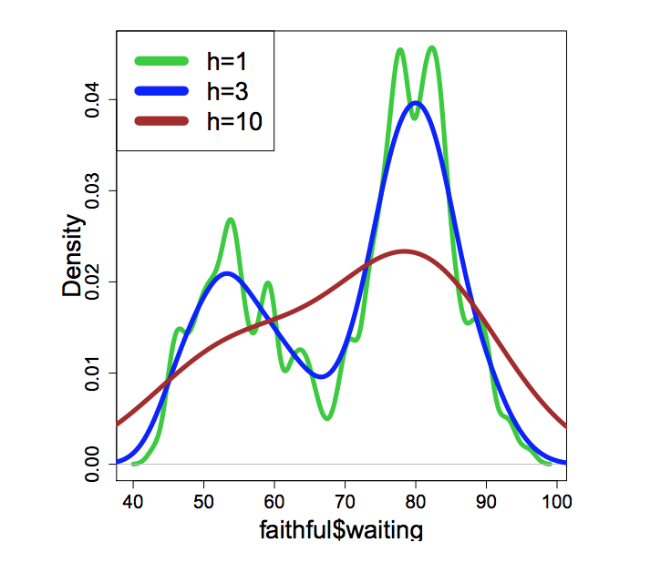
KDE - Bandwidth
Choosing the right bandwidth is essential in finding the best estimate. Narrow bandwidth leads to high variance (capturing every detail of the data) and and wide bandwidth leads to high bias (losing to capture essential information).

Slide 29
KDE - sklearn
import scipy.stats as scs
data = scs.distributions.norm(0.1,0.7).rvs(size=50)
from sklearn.neighbors import KernelDensity
x = np.linspace(-2, 2, 400)
kde = KernelDensity(bandwidth=.1, kernel='gaussian')
kde.fit(data[:, None])
# score_samples returns the log of probability density
logprob = kde.score_samples(x[:, None])
plt.fill_between(x, np.exp(logprob), alpha=0.5)
plt.plot(data, np.full_like(data, -0.1), '|k', markeredgewidth=1)
plt.ylim(0, 1)

Slide 30
Parametric vs Non-Parametric
Parametric: We assume an underlying distribution, then we use our data to estimate the parameters of that underlying distribution. E.g. Using:
Method of Moments (MOM)
Maximum Likelihood Estimation (MLE)
Maximum a Posteriori (MAP)
Nonparametric: We don’t assume any single underlying distribution, but instead we fit a combination of distributions to the observed data. E.g. Using:
Kernel Density Estimation (KDE)

Slide 31
When to Use Which Method
Parametric methods:
Based on assumptions about the distribution of the underlying population and the parameters from which the sample was taken.
If the data deviates strongly from the assumptions, could lead to incorrect conclusions.
Nonparametric methods:
NOT based on assumptions about the distribution of the underlying population.
Generally not as powerful -- less inference can be drawn.
Interpretation can be difficult… what does the wiggly curve mean?

